Slide 1
ECE20016-01/ITP20003 Java Programming
Object-oriented Programming Concept
JC

Slide 2
Tentative Schedule
Weeks | Topics
1 | Introduction Java Runtime environments
2 | Object-oriented concept Packages and objects
3 | Class and its members
4 | Language Basics, Branching and Loop
5 | String and Number classes
6 | Arrays, Recursion
7 | Inheritance, Polymorphism, and Interfaces Abstract data type and Interfaces
8 | Basic data structures ArrayList
9 | HashMap Midterm Exam
10 | Exception Handling, Streams and File I/O (1)
11 | Streams and File I/O (2), Java Programming practice (1)
12 | Java Programming practice (2), Dynamic Data structure and Generics (1)
13 | Dynamic Data structure and Generics (2) GUI and Event-driven Programming (1)
14 | GUI and Event-driven Programming (2), Concurrency (1)
15 | Concurrency (2) , Summary
16 | Final
* This schedule can be modified according to the students’ performance and other reasons.

Slide 3
Object-Oriented Concept
https://docs.oracle.com/javase/tutorial/java/concepts/index.html
Textbook: Ch9.1-9.3 (p.346~353)

Slide 4
Object-oriented Programming Concept
Objects
Classes
Object-oriented program
Inheritance
Packages
Interfaces

Slide 5
Objects in Java
State ⇒ Fields in Java
Behavior ⇒ Methods in Java
Fields (State)
Methods (Behavior)
A software object

Slide 6
Objects in Java
State ⇒ Fields in Java
Behavior ⇒ Methods in Java
Change gears
30 Km/h
Brake
5th gear
Change cadence
A bicycle modeled as a software object

Slide 7
Benefits of Coding based on objects
Modularity
Information-hiding
Code reuse
Pluggability and debugging ease
Notes:
Modularity: The source code for an object can be written and maintained independently of the source code for other objects. Once created, an object can be easily passed around inside the system.
Information-hiding: By interacting only with an object's methods, the details of its internal implementation remain hidden from the outside world.
Code re-use: If an object already exists (perhaps written by another software developer), you can use that object in your program. This allows specialists to implement/test/debug complex, task-specific objects, which you can then trust to run in your own code.
Pluggability and debugging ease: If a particular object turns out to be problematic, you can simply remove it from your application and plug in a different object as its replacement. This is analogous to fixing mechanical problems in the real world. If a bolt breaks, you replace it, not the entire machine.

Slide 8
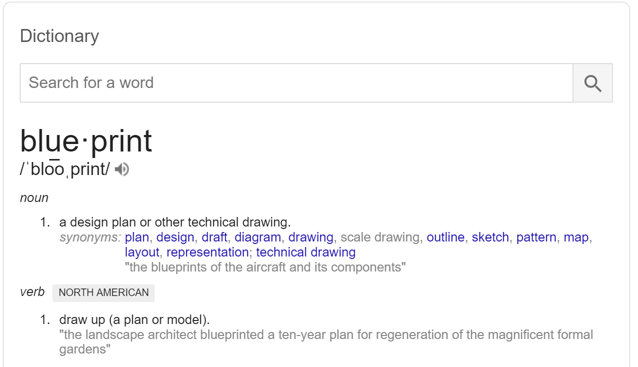
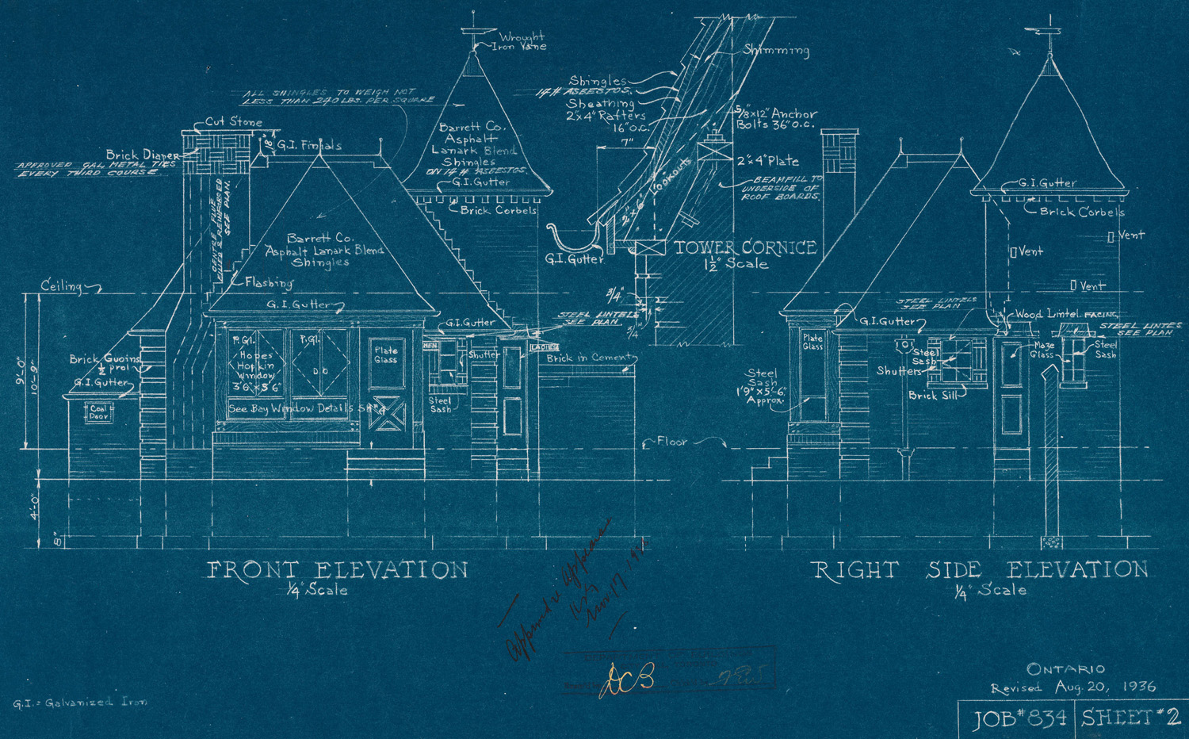
What is a class?
A blueprint of an object.

Slide 9
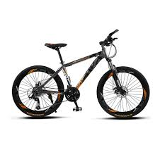
What is a class?
Objects: Concept
A class: Detailed specification of objects.
Usually defined as a Java source code file
An instance: A real object created based on the class.
Example
"My bicycle is an instance of the class of objects known as bicycles."

Slide 10
Example: Bicycle class in Java
Bicycle
- currentCadence - currentGear - speed
+ changeGear() + changePedalCadence() + applyBrake() + printStates()
class Bicycle { private int cadence = 0; // paddling rate private int gear = 1; private int speed = 0; public void changePadalCadence(int newValue) { cadence = newValue; } public void changeGear(int newValue) { gear = newValue; }
public void applyBrakes(int decrement) { speed = speed - decrement; } public void printStates() { System.out.println("cadence: " + cadence + "speed:" + speed" + "gear:" + gear"); } }

Slide 11
Object-oriented Programming Concept
Objects
Classes
Object-oriented program
Inheritance
Packages
Interfaces

Slide 12

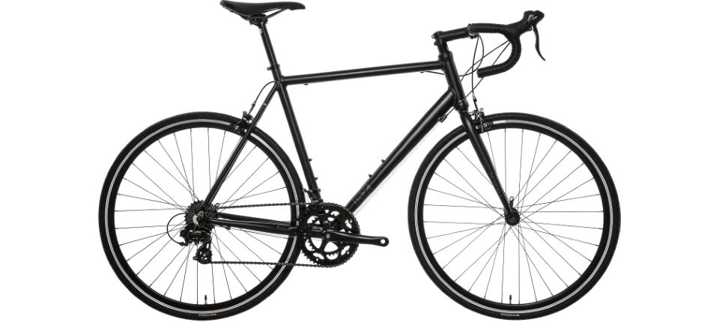
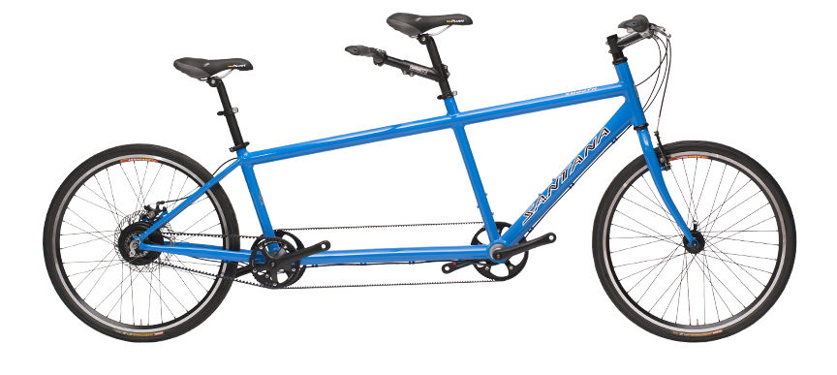
What is inheritance?
Change gears
current speed
Brake
current gear
Change cadence
Bicycle class
Mountain Bike class
Road Bike class
Tandem Bike class

Slide 13
What is inheritance?
Change gears
current speed
Brake
current gear
Superclass
Change cadence
Bicycle class
Subclasses
Mountain Bike class
Road Bike class
Tandem Bike class

Slide 14
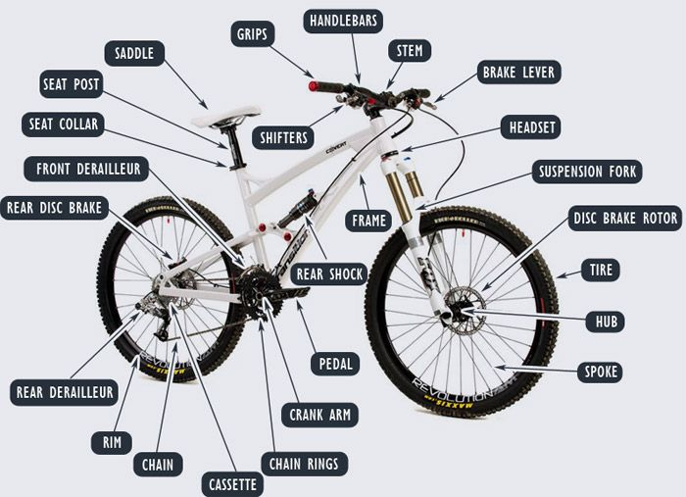
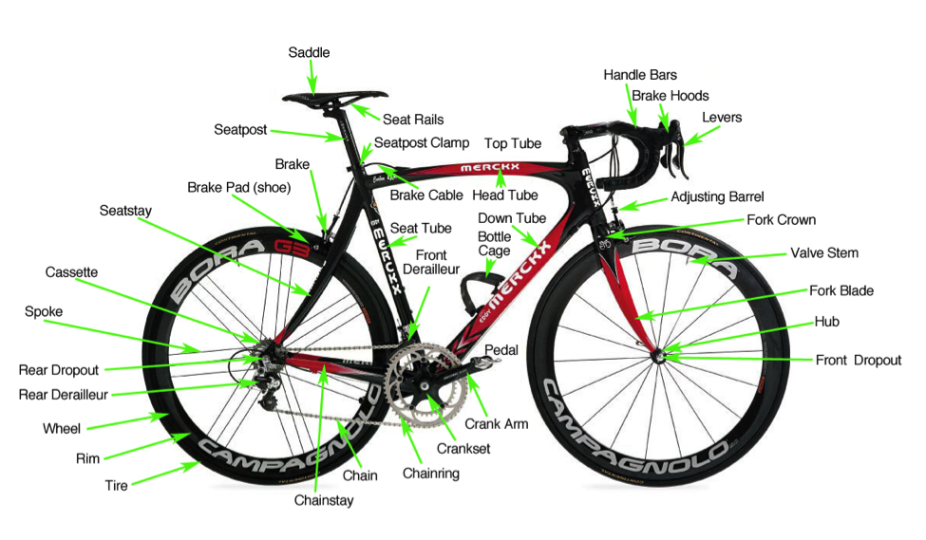

Slide 15
What is inheritance?
Bicycle
Superclass
MTBBike
RoadBike
TandemBike
Subclasses

Slide 16
What is inheritance?
Bicycle
Superclass
(Parent)
Be careful for the arrow direction!
MTBBike
RoadBike
TandemBike
Subclasses
(Child)

Slide 17
Example: Person, Professor, Student, Staff classes in Java
class Person { // fields and methods defining
}

Slide 18
Example: Person, Professor, Student, Staff classes in Java
class Professor extends Person { // Fields and methods of Person are automatically inherited. // new fields and methods defining for the Professor class } class Student extends Person { ... } class Staff extends Person { ... }

Slide 19
Object-oriented Programming Concept
Objects
Classes
Object-oriented program
Inheritance
Packages
Interfaces

Slide 20
What is an interface?
Contact point to interact with other objects.
A header of a method without body in Java interface Bicycle { // wheel revolutions per minute void changeCadence(int newValue); void changeGear(int newValue); void speedUp(int increment); void applyBrakes(int decrement); }

Slide 21
What is an interface?
A method in a class plays a role for an interface, then why do we need to define interface in Java???? "Implementing an interface allows a class to become more formal about the behavior it promises to provide. Interfaces form a contract between the class and the outside world, and this contract is enforced at build time by the compiler. If your class claims to implement an interface, all methods defined by that interface must appear in its source code before the class that implements the interface will successfully compile."
Mechanism to guarantee clearer and safer program design and implementation.

Slide 22
Example: ACMEBicycle class that implements Bicycle interface!
class ACMEBicycle implements Bicycle { int cadence = 0; int speed = 0; int gear = 1; // The compiler will now require that methods // changeCadence, changeGear, speedUp, and applyBrakes // all be implemented. Compilation will fail if those // methods are missing from this class. void changeCadence(int newValue) { cadence = newValue; } void changeGear(int newValue) { gear = newValue; }
void speedUp(int increment) { speed = speed + increment; } void applyBrakes(int decrement) { speed = speed - decrement; } void printStates() { System.out.println("cadence:" + cadence + " speed:" + speed + " gear:" + gear); } }

Slide 23
Object-oriented Programming Concept
Objects
Classes
Object-oriented program
Inheritance
Packages
Interfaces

Slide 24

What is a package?
A namespace that organizes a set of related classes and interfaces.
Physically a directory/folder that have class files in your computer.
Can get various packages online: https://mvnrepository.com/
By convention, a package name is defined by a reversed domain name meaningful!
e.g., edu.hadong.csee.isel.jc
A class library = a set of packages
Application Programming Interface (API)
A set of reusable classes
Example: https://docs.oracle.com/javase/8/docs/api/index.html
Bicycle
MTBBike
TandemBike
RoadBike
e.g., A package name: edu.handong.csee.bikes

Slide 25
Object-oriented Programming Concept
Objects
Classes
Object-oriented program
Inheritance
Packages
Interfaces

Slide 26
Q&A

Slide 27
Tentative Schedule
Weeks | Topics
1 | Introduction Java Runtime environments
2 | Object-oriented concept Packages and objects
3 | Class and its members
4 | Language Basics, Branching and Loop
5 | String and Number classes
6 | Arrays, Recursion
7 | Inheritance, Polymorphism, and Interfaces Abstract data type and Interfaces
8 | Basic data structures ArrayList
9 | HashMap Midterm Exam
10 | Exception Handling, Streams and File I/O (1)
11 | Streams and File I/O (2), Java Programming practice (1)
12 | Java Programming practice (2), Dynamic Data structure and Generics (1)
13 | Dynamic Data structure and Generics (2) GUI and Event-driven Programming (1)
14 | GUI and Event-driven Programming (2), Concurrency (1)
15 | Concurrency (2) , Summary
16 | Final
* This schedule can be modified according to the students’ performance and other reasons.

Slide 28

TODOs for L04: How does a java program work? Read https://docs.oracle.com/javase/tutorial/getStarted/intro/index.html
Read the textbook: Ch.1.1 ~ 1.6
JC Nam, jcnam@hadong.edu, https://lifove.github.io

